Slide 1

Automated Parking
Submitted by:
Japman Singh (G12/49/CSE1/2017)
Japneet Singh (G12/50/CSE1/2017)
Jaskaran Singh Kawatra (G12/53/CSE1/2017)
Jaskirat Singh (G12/54/CSE1/2017)
Under the guidance of:
Ms. Basanti Pal Nandi
Department of Computer Science & Engineering
Guru Tegh Bahadur Institute of Technology

Slide 2
Automated Parking
Introduction
Problem Statement
Objective
Technologies Used
Procedure for Deep Learning Model
Procedure for Flutter Application
Flow Diagrams
ER Diagram
Project Demonstration
Conclusion
Future Prospects
References

Slide 3
Introduction
Automated Parking, a one stop solution for all parking problems. Our project takes care of available parking spaces, ticketing and all parking related charges and payments with support for both Android and IOS devices.
Problem Statement
With increasing modernization and automation in daily tasks, one task that still stays manual is parking systems. We aim to solve the problem of manual parking management systems which are labor intensive contactless and automated to minimize any inconveniences caused.

Slide 4
Objective
The aim of the project is to identify and detect the number plate of a car and then use that information to help the user pay their parking fee through an application. It involves the following steps:
Getting user registered on the application
Setting up a camera on parking boom barrier
Deploying the AI model with OCR and uploading results to Firebase
Providing user with an application to manage account and logs
Providing the administrator with real time dashboard to manage parking site
All these processes are implemented using Open CV, Google Colab, Anaconda, Jupyter Notebook, Python Tesseract, Firebase, Flutter, Dart, Vehicle Info Restful API and numerous other libraries and technologies.

Slide 5
Technologies used: 1. Labelbox 2. Colab 3. Jupyter Notebook 4. Keras 5. OpenCV 6. PyTesseract 7. Firebase 8. Flutter (Android, iOS, Web App)
Our project consists of 4 elements
Deep Learning Model trained for number plate recognition.
OpenCV program for plate detection and O.C.R
Flutter application to manage data and make payments.
Web Application for Admin console.

Slide 6
Open CV
OpenCV (Open Source Computer Vision Library) is an open source computer vision and machine learning software library. OpenCV was built to provide a common infrastructure for computer vision applications and to accelerate the use of machine perception in the commercial products. OpenCV makes it easy for businesses to utilize and modify the code. The library has more than 2500 optimized algorithms, which includes a comprehensive set of both classic and state-of-the-art computer vision and machine learning algorithms.
Tensor Flow
TensorFlow is a free and open-source software library for machine learning. It can be used across a range of tasks but has a particular focus on training and inference of deep neural networks. Tensorflow is a symbolic math library based on dataflow and differentiable programming. It is used for both research and production at Google.

Slide 7
Colab
Colab is a free Jupyter notebook environment that runs entirely in the cloud. Most importantly, it does not require a setup and the notebooks that you create can be simultaneously edited. It also offers GPU support for training Deeplearning models.
Py-Tesseract
Py Tesseract or Python-tesseract is an Optical Character Recognition (OCR) tool for Python. It will read and recognize the text in images, license plates etc. Python-tesseract is actually a wrapper class or a package for Google’s Tesseract-OCR Engine. It is also useful and regarded as a stand-alone invocation script to tesseract, as it can easily read all image types supported by the Pillow imaging libraries

Slide 8
Firebase
Firebase is an ecosystem of Google tools that can be used to make full-stack, scalable applications in the Google Cloud (called Cloud Firestore) or Realtime Database. It is categorized as a backend-as-a-service (or BaaS) which gives developers the opportunity to create applications without the hassle of setting up the backend. It is a blend of SQL and NoSQL databases.
Flutter
Flutter is an open-source UI software development kit created by Google. It is used to develop applications for Android, iOS, Linux, Mac, Windows and the web from a single code base. The first version of Flutter was known as codename "Sky" and ran on the Android operating system. It was unveiled at the 2015 Dart developer summit, with the stated intent of being able to render consistently at 120 frames per second.

Slide 9
Procedure for Deep Learning Model
Install a Python distribution with Jupyter Notebook support or use Google Colab’s Jupyter Notebook.
Click pictures manually as well as collect from the internet.
3. Label number plates data using Label Box.
4. Export this data to JSON file.
5. Load it into Pandas dataframe.
6. Train the detection model.
7. Test the model on test cases.
8. Make the model converge.
9. Crop detected image and feed it to Python Tesseract OCR
10. Upload OCR detected output on firebase.

Slide 10
Procedure for Flutter Application
Get the Flutter SDK: Download the installation bundle to get the latest stable release of Flutter.
Setup Android Studio for flutter.
Connect application with Firebase Backend.
Code the Sign-In module with support for Google sign-in from Firebase.
Create Parking, Logs and MyAccount screens and build the flow.
Code the Add Vehicle screen and integrate VehicleInfo-RestfulAPI to obtain Car details from number plate.
Add vehicle details in Cloud-Firestore.
Fetch vehicle number from AI-Model-PyTesseract output and generate parking log in Firebase.
Respond to ping when same number plate is detected at exit. Calculate fare using timestamp and debit amount from payment gateway.

Slide 11
Flow Diagrams

Slide 12
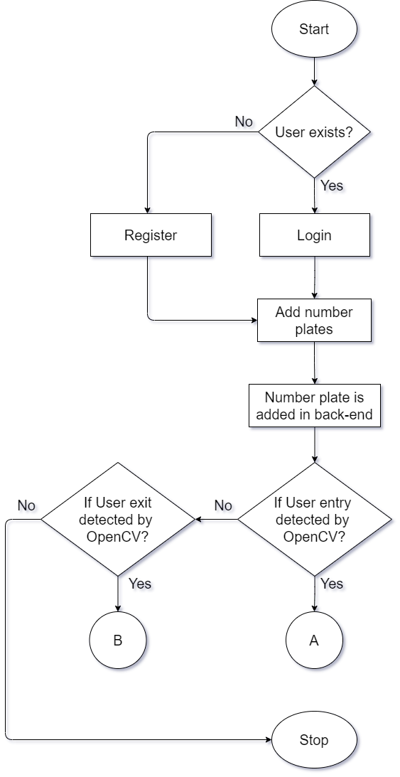
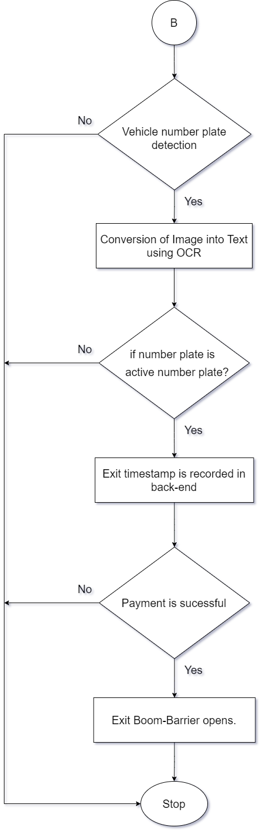
Fig – Application Flow Automated Parking (1)
Fig – Application flow Automated Parking (2)
Fig – Application flow Automated Parking (3)

Slide 13
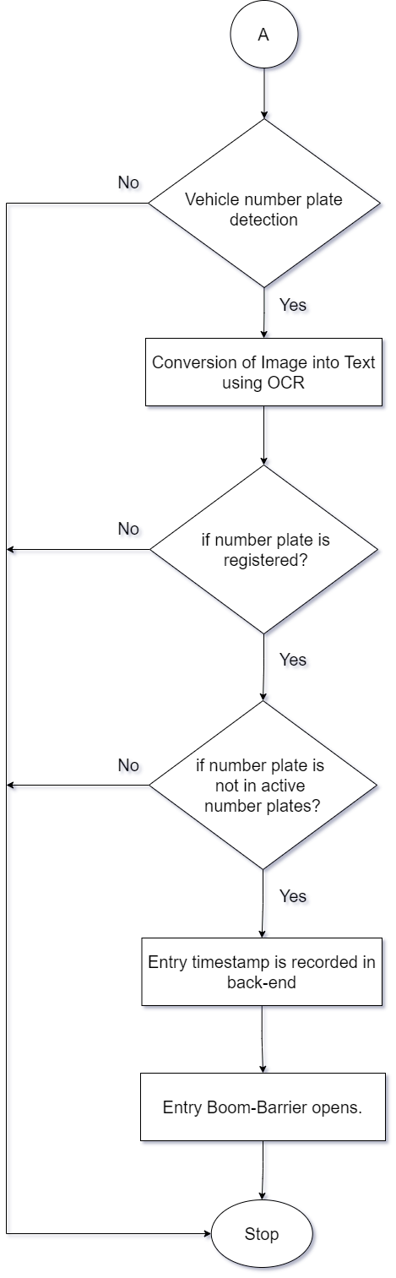
Fig – Application Flow Automated Parking (2)

Slide 14
Fig – Application Flow Automated Parking (3)

Slide 15
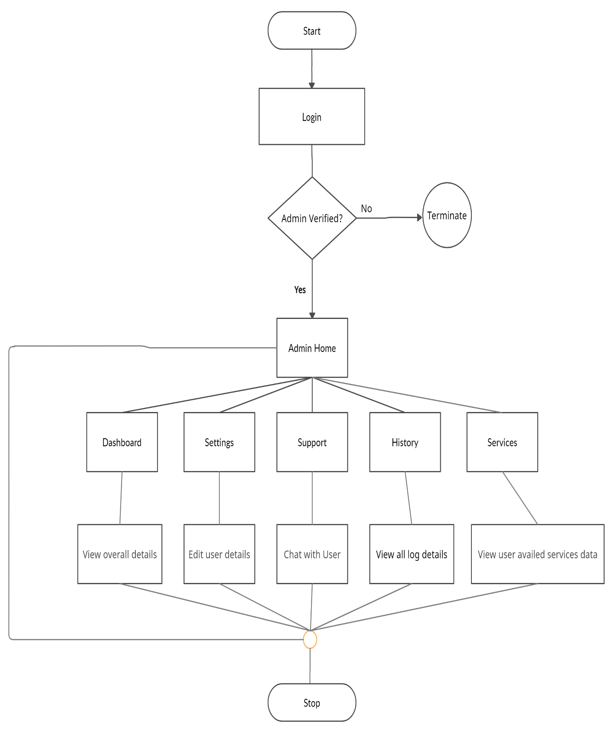
Fig. Admin Console Flow

Slide 16
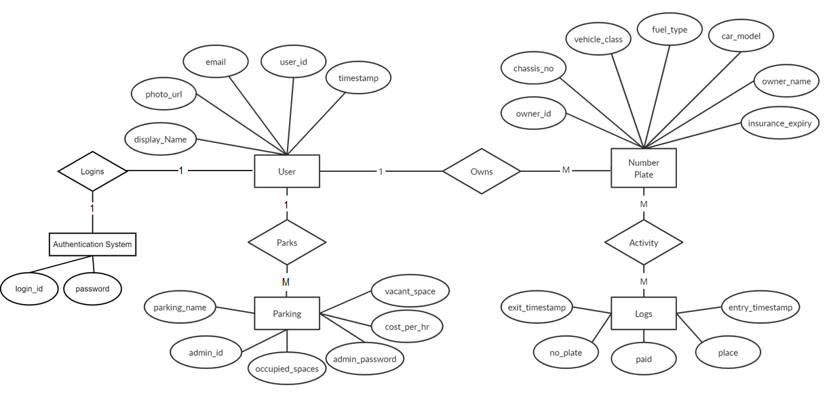
Fig. ER Diagram

Slide 17
Project Demonstration

Slide 18
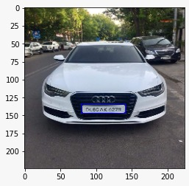
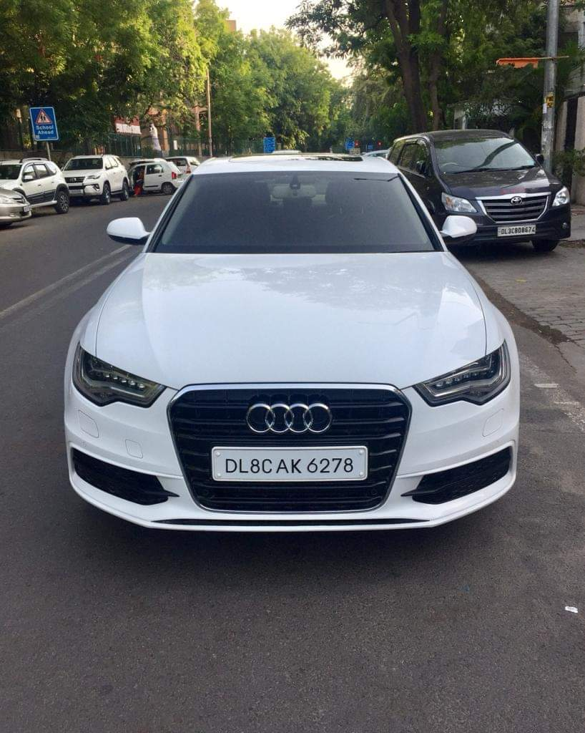
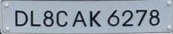
The system has been tested on a series of different test cases based on various types of number plates in India and also abroad.
Expected Output
Expected Output Sample (For Reference)

Slide 19
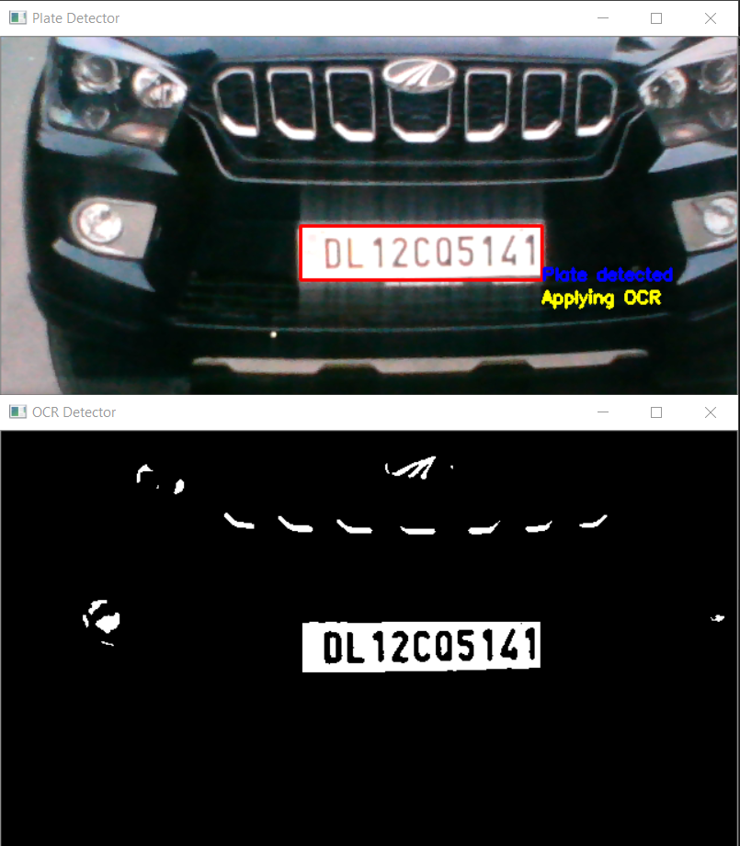
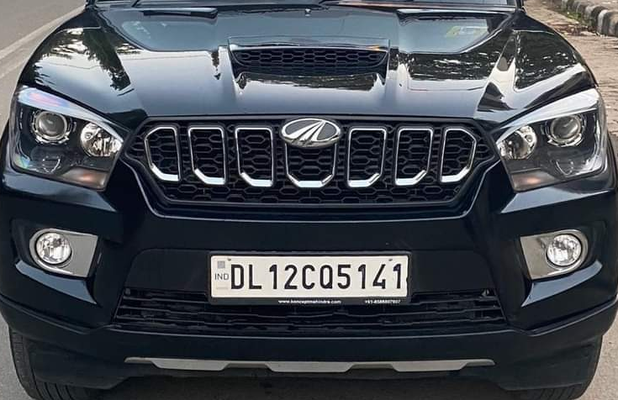
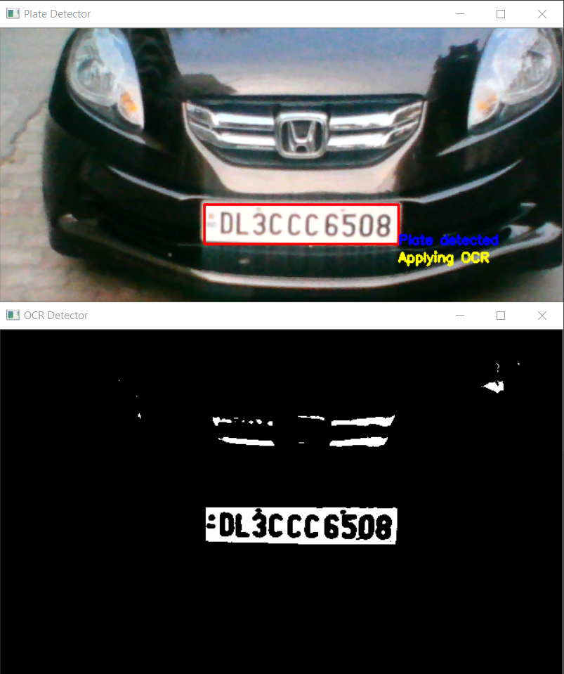
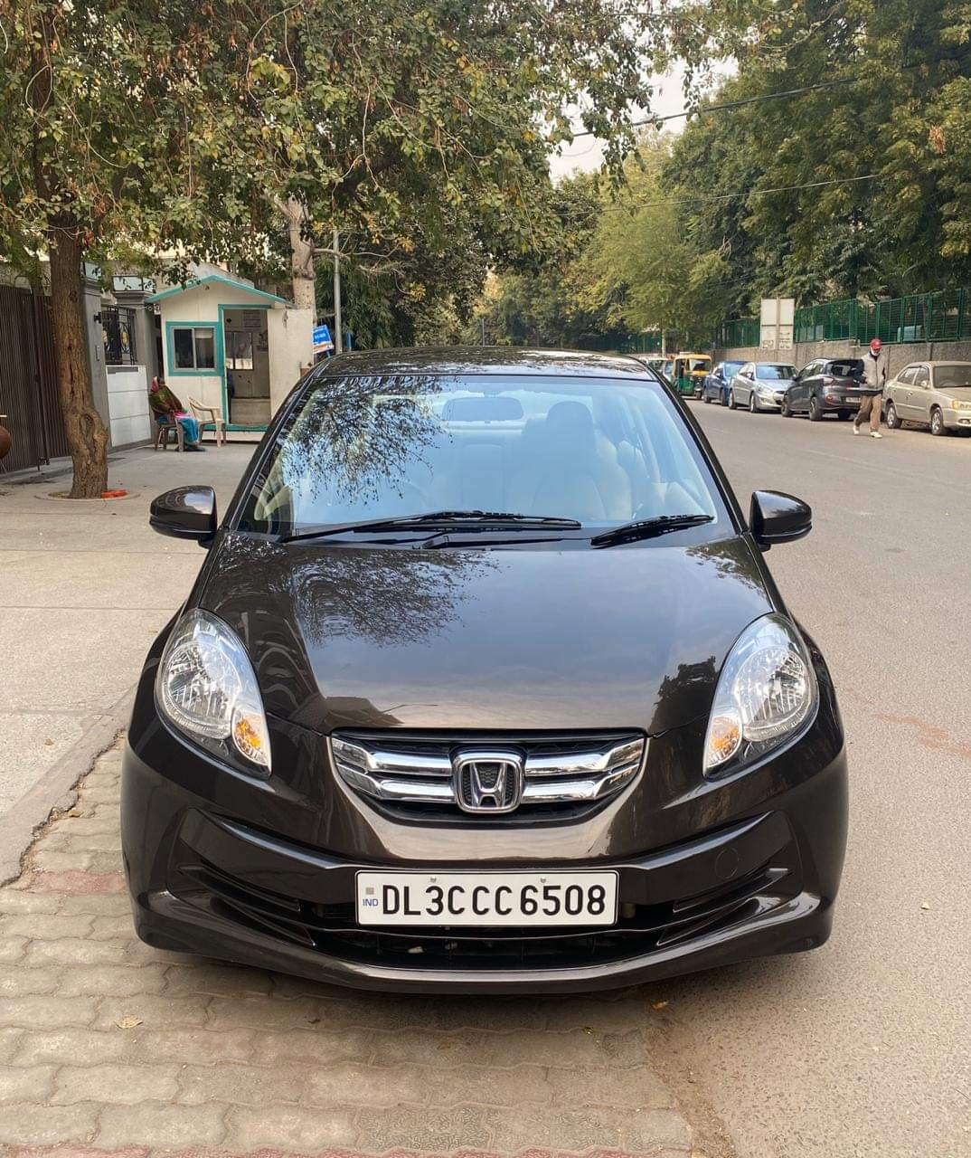
Test Case(1) – Plate Detection
Status - Success
Input Camera Feed
Detected Plate and Mask
Test Case(2) – Plate Detection
Status - Success
Input Camera Feed
Detected Plate and Mask

Slide 20
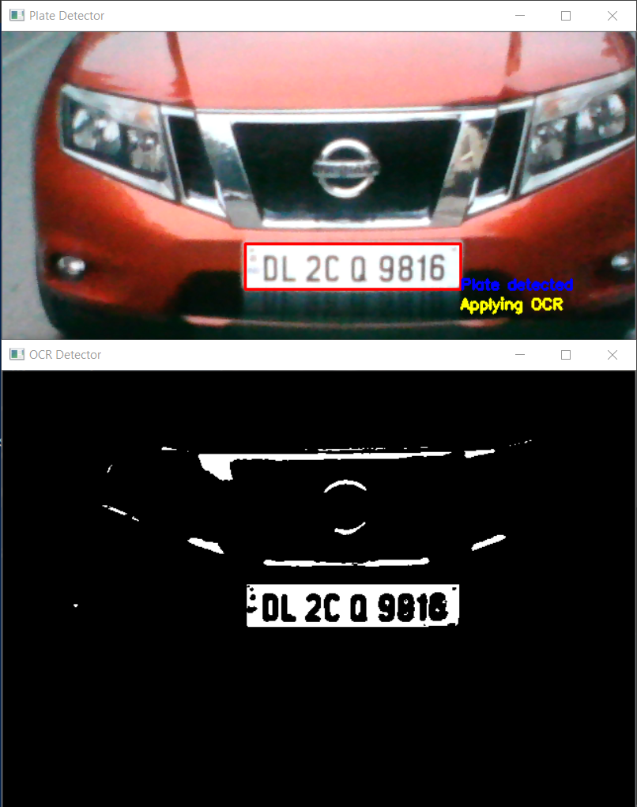
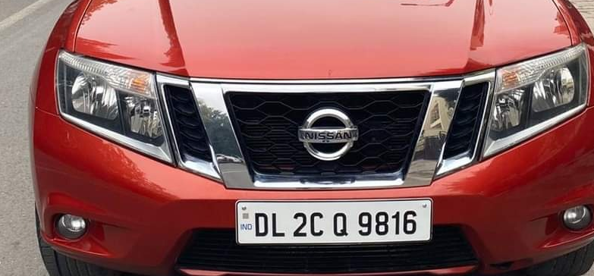
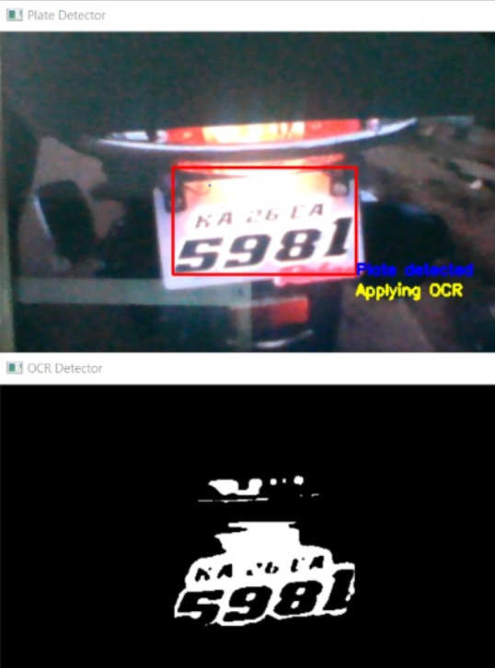
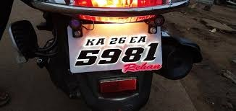
Test Case(3) – Plate Detection
Status - Success
Input Camera Feed
Detected Plate and Mask
Test Case(4) – Plate Detection
Status - Success
Input Camera Feed
Detected Plate and Mask

Slide 21
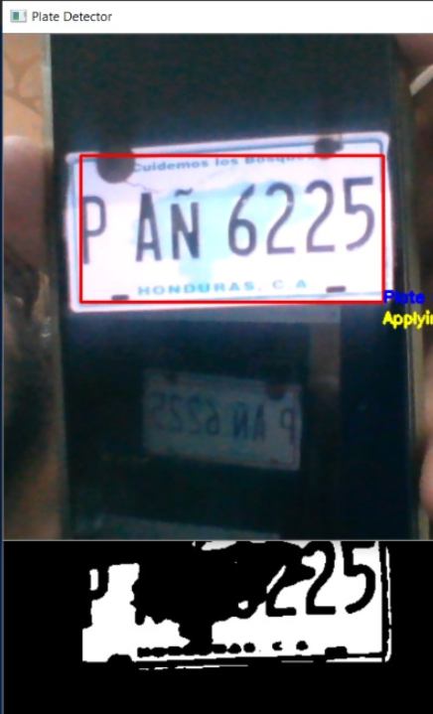
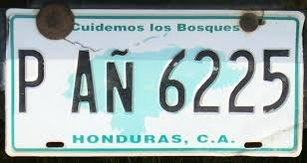
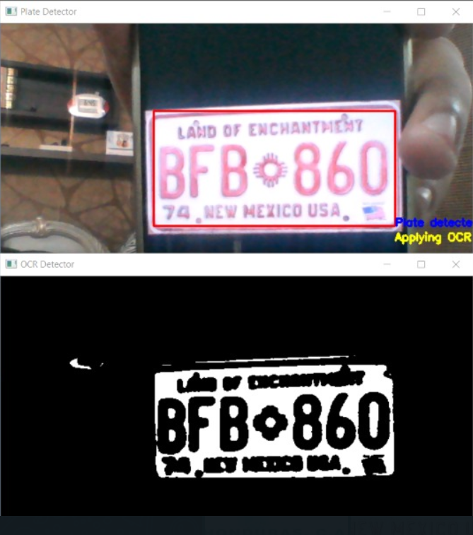
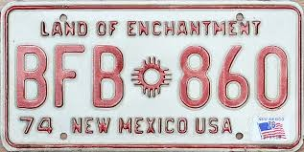
Test Case(5) – Plate Detection
Status - Success
Input Camera Feed
Detected Plate and Mask
Test Case(6) – Plate Detection
Status - Success
Input Camera Feed
Detected Plate and Mask

Slide 22
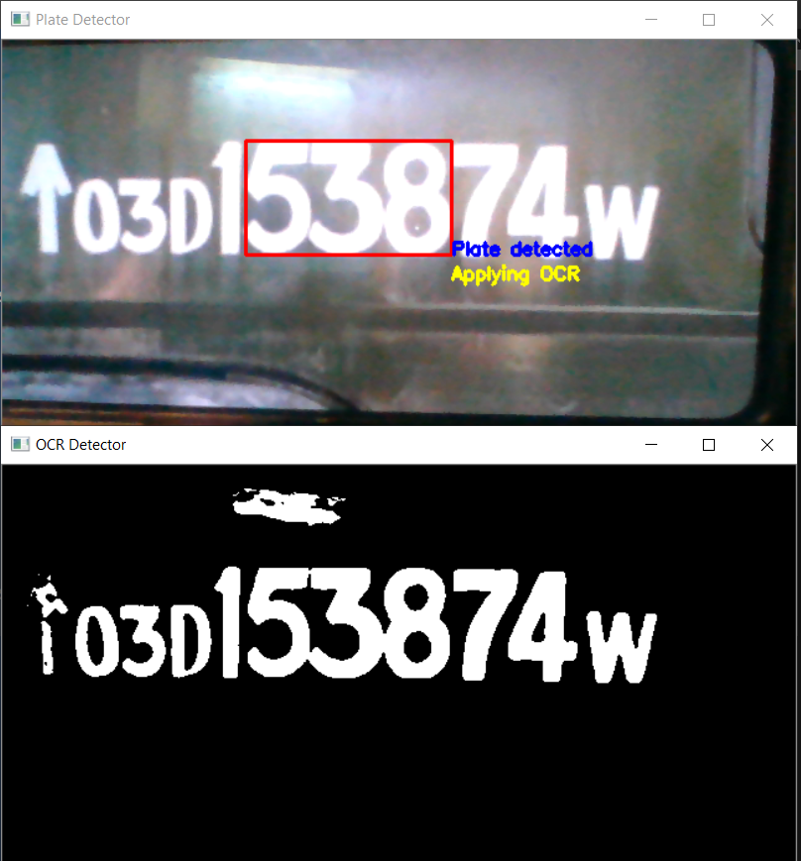
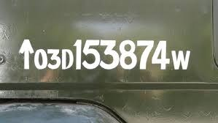
Test Case(7) – Plate Detection
Status - Failed
Input Camera Feed
Detected Plate and Mask
Test Case(1) – OCR
Status - Success

Slide 23
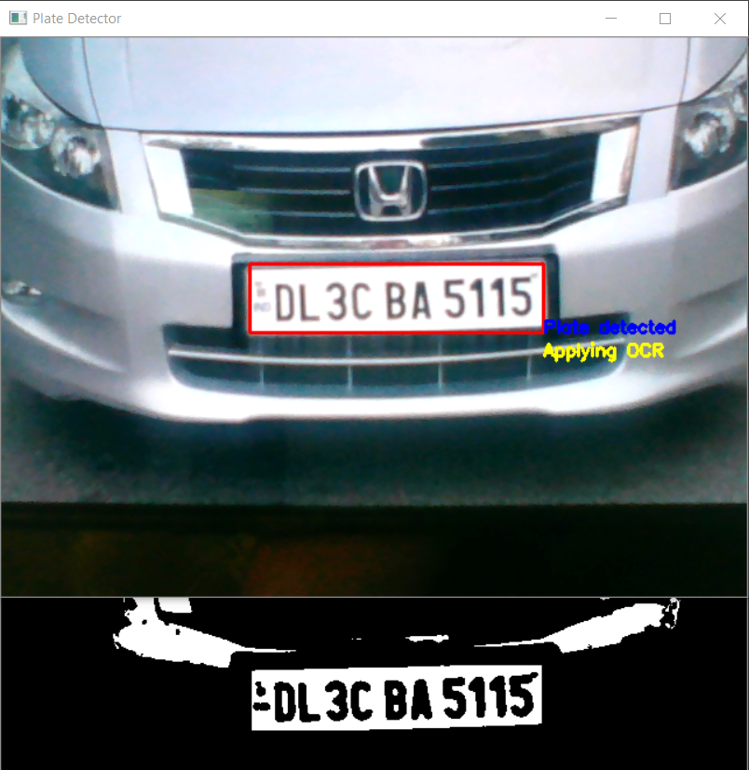

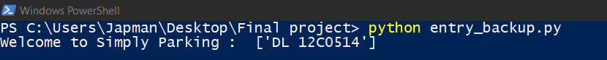
Test Case(2) – OCR
Status - Success
Test Case(3) – OCR
Status - Failed
Reason – Due to Q similar to 0, the system detects last 4 digits as 0514 instead of 5141

Slide 24
Test Case(4) – OCR
Status - Failed
Reason –
Due to Regex based on Indian format, detection fails
Detected Plate and Mask
Test Case(5) – Plate Detection
Status - Failed
Reason –
Due to Regex based on Indian format, detection fails
Detected Plate and Mask

Slide 25
Conclusion
The system was designed in such a way that future modifications can be done easily. The following conclusions can be deduced from the development of application.
It provides a friendly graphical user interface which proves to be better for user.
It will help users to avoid long queues at parking and avoid the wastage of time.
It makes the parking system less tedious and hassle-free.
It is a simple and efficient solution for the users to experience an automated parking system.
The User interacts with an interface which simulates an automated parking system wherein the user’s car number plate can be identified and based on the plate number and the number of hours elapsed at the parking destination, the user is charged on the app itself
It also provides the business owner a dashboard interface to track vacant parking spaces and revenue generated in real-time.

Slide 26
Future Prospects
The software can be further enhanced with the addition of country specific number plate data sets.
The accuracy in OCR detection for all number plates in general is 88% and is as high as 92% for the high security registration plate approved by the government of India. In future, we can work on increasing the accuracy even further.
UI changes can be made to match latest trends in the industry.
Login from Facebook, LinkedIn, and E-Mail can also be implemented.

Slide 27
References
Books, Journals and Articles
[1] O’Reilly - Hands On Machine Learning with ScikitLearn, Keras and TensorFlow, Pg 80-165
[2] Allibai, E. (2018, November 21). Building a deep learning model using Keras. Medium. https://towardsdatascience.com/building-a-deep-learning-model-using-keras-1548ca149d37
[3] Zhang, Wei (1988). "Shift-invariant pattern recognition neural network and its optical architecture". Proceedings of Annual Conference of the Japan Society of Applied Physics.
[4] Vishal Gupta – Restful API Guide - https://shrouded-falls-48764.herokuapp.com/docs/readme.html
[5] Venkatachalam, M. (2020, May 14). Introduction to object detection. Medium. https://towardsdatascience.com/introduction-to-object-detection-943f21e26063
[6] Labenz, C. (2020, October 15). Testable flutter and cloud Firestore. Medium. https://medium.com/flutter/testable-flutter-and-cloud-firestore-1cf2fbbce97b
[7] Uther, ​. (2017). Temporal difference learning. Encyclopedia of Machine Learning and Data Mining, 1233-1240. https://doi.org/10.1007/978-1-4899-7687-1_817
[8] Wright, S. (2013). App logic components. Pro SharePoint 2013 App Development, 245-282. https://doi.org/10.1007/978-1-4302-5885-8_9
Online References
[1] https://flutter.dev/docs/reference/tutorials
[2]. https://www.w3adda.com/flutter-tutorial
[3] https://stackoverflow.com/questions/49072957/flutter-dart-open-a-view-after-a-delay
We would also like to thank the Teaching Faculty at GTBIT, our HOD Dr. Aashish Bhardwaj and our Mentor for the Project, Ms. Basanti Pal Nandi for their immense efforts in making this project successful.

Slide 28
THANK YOU

